Slide 1
Room Occupancy Estimation
Machine Learning Project
Azzam Abdulrahman AlFurhud

Slide 2
Dataset Overview
10,129 observations | 16 attributes
Attribute Name | Description
Date | YYYY/MM/DD
Time | HH:MM:SS
Temperature S1 – S4 | In degree Celsius
Light S1 – S4 | In Lux
Sound S1 – S4 | In Volts (amplifier output read by ADC)
CO2 S5 | In PPM (parts per million)
CO2 Slope S5 | Slope of CO2 values taken in a sliding window
PIR S6 – S7 | Binary value conveying motion detection
Room_Occupancy_Count (Target) | Number of people in the room (Manually Noted Ground Truth)

Slide 3
EDA
Due to some features not only correlated but giving the same information through different sensors I believed it is better to aggregate them as follows:
- Temperature – Sound – Light : Average
- PIR : Summation
I could not find appropriate use for the date\time so I did not include it in the models
The dataset did not have any null or duplicates

Slide 4
Defining the features and target
Features included: All the aggregated values + CO2 and CO2 slope
Target: Room occupancy count
Data was split into training (80%) and testing (20%)
The features were also standardized for comparison of model performance with non-standardized features

Slide 5
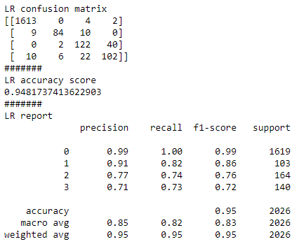
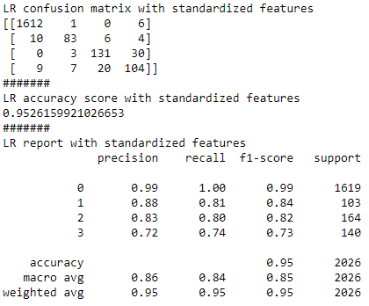
Logistic Regression

Slide 6
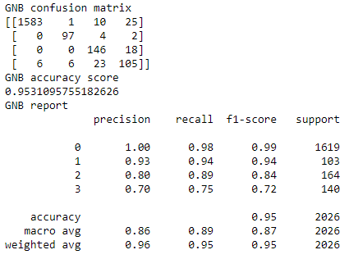
Gaussian Naïve Bayes

Slide 7
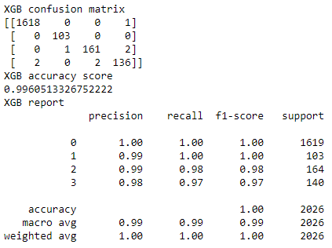
XGboost

Slide 8
Models Comparison
Metrics | Logistic Regression (Standardized features) | Gaussian Naïve Bayes | XGboost
F1 Score (Macro Average) | 0.85 | 0.87 | 0.99
F1 Score (Weighted Average) | 0.95 | 0.95 | 1.00
Accuracy | ~ 0.9526 | ~ 0.9531 | ~ 0.9960
XGboost won on every metric as shown in the table above

Slide 9
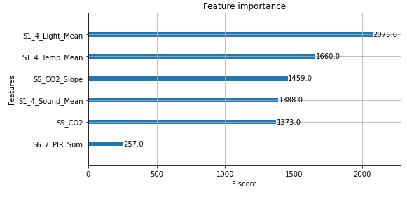
Features Importance using the winning model (XGboost)

